Slide 1
Interfaces & Interconnect
V.SRAVANTHI
CHIPWEAVE TECHNOLOGIES PVT LTD

Slide 2
CONTENTS
Introduction
Why & What is Interface ?
Status Information
Types of Interfaces
What is Interconnect?
Types of Interconnect
Comparision between Interface and Interconnect

Slide 3
Introduction
Correct communication requires:​
Well-defined interfaces​
Efficient interconnect fabrics​
Communication in a chip is built using three layers:​
Interface → Defines rules​
Interconnect → Defines paths​
Physical layer → Implements wires​
This presentation focuses on Interface vs Interconnect.​

Slide 4
Why Interface?
A peripheral device sends and receives data at a specific speed and in a particular format.
The CPU or computer system also processes data at its own speed and format.
Because of these differences, direct communication between the CPU and peripheral devices may cause compatibility issues.

Slide 5

What is Interface?
An interface is a unit that sits between the CPU and a peripheral device and compensates for differences in speed, data format, and communication codes to ensure compatibility.

Slide 6
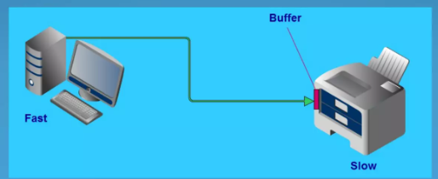
Buffer
• Most interfaces use buffers to temporarily store blocks of data during transfer between the processor and peripheral devices.
• Buffers allow data to be stored temporarily until the peripheral device is ready to process it.
• They also keep track of the status of the peripheral, so the processor knows when it can send or receive data and when an error occurs.

Slide 7
Types of Interfaces
There are 3 types of interfaces are there
Communication & Protocol Interfaces
System Verilog Design Interfaces
Mixed-Signal & Analog Interfaces

Slide 8
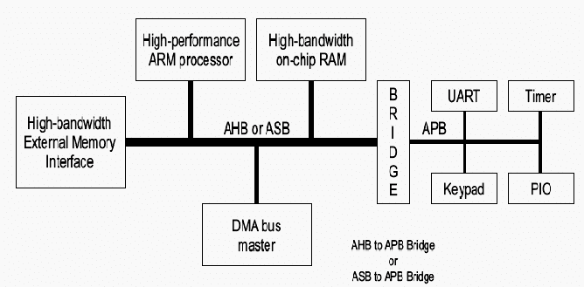
Communication & Protocol Interfaces
High-Speed Serial (USB, PCIe, HDMI):
High-bandwidth links used for massive data transfer between the SoC and external devices.
Bus Protocols (AMBA AXI/AHB/APB):
Standardized on-chip communication paths that manage data flow between internal processors, controllers, and peripherals.

Slide 9
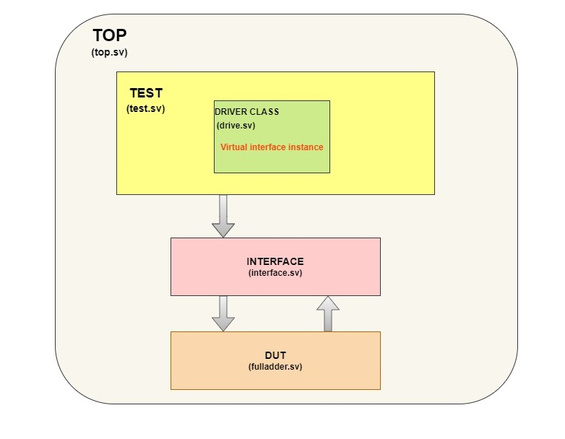
System Verilog Design Interfaces
Static Interface: A bundle of signals and wires that encapsulates communication between modules to reduce code complexity and port list size.
Virtual Interface: A dynamic pointer to a physical interface used in verification environments (like UVM) to enable object-oriented testbench reuse.

Slide 10
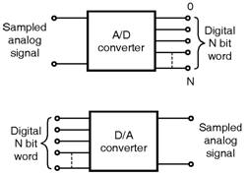
Mixed-Signal & Analog Interfaces
Data Converters (ADC/DAC):
Bridges that translate real-world analog signals into digital data (and vice-versa)
for processing by the chip's logic.
Clocking Interfaces (PLL/DLL): Specialized circuits that synchronize data transfer and
distribute stable clock signals across various chip domains.

Slide 11
Interconnect
Interconnect is the communication Path that connects multiple interfaces and IP blocks inside an SOC.​
It acts as the backbone of the SOC, enabling data transfer between different masters and slaves through their interfaces.​
The interconnect defines the data flow paths across the SoC, determining how and where data moves between different components.​

Slide 12
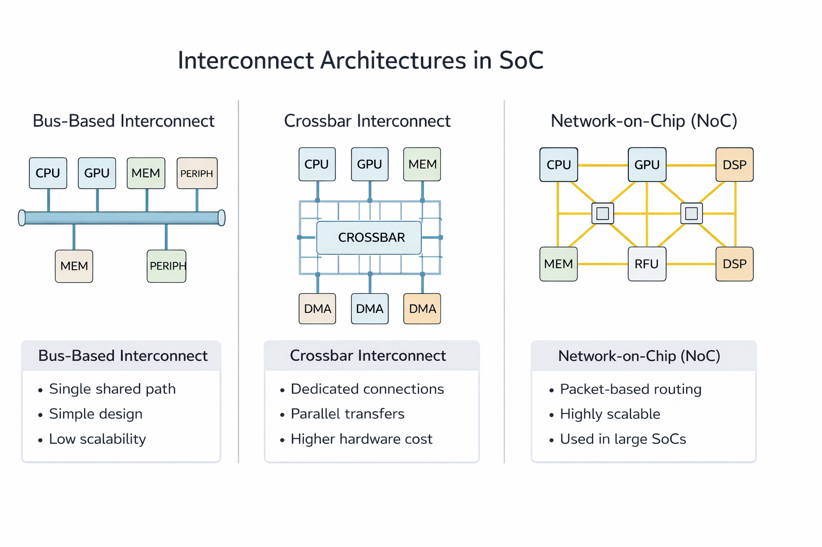
Types of Interconnect

Slide 13
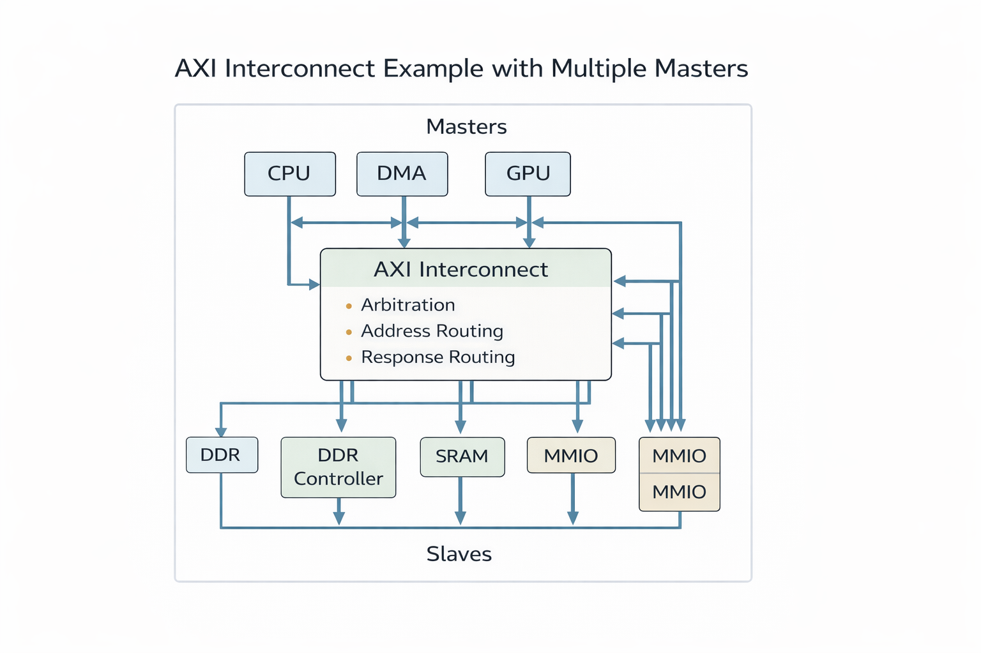
RTL/SOC Example of an Interconnect ​

Slide 14
Interface VS Interconnect ​
Feature | Interface | Interconnect
Definition | An interface is a communication boundary that allows two components or modules to interact. | An interconnect is a network or communication path that connects multiple components within a system.
Purpose | Enables communication between two devices or modules. | Provides connectivity between multiple modules or subsystems.
Scope | Usually connects a specific device or module. | Connects many modules across the system.
Function | Defines signals, protocols, and communication rules. | Transfers data between different blocks through buses or networks.
Examples | GPIO interface, USB interface, PCIe interface. | AXI bus, AHB bus, Network-on-Chip (NoC).
Level in System | Component-level communication. | System-level communication infrastructure.
Complexity | Relatively simpler. | More complex because it manages multiple connections and arbitration.
Usage | Used to connect external devices or modules. | Used to connect internal components inside a chip or system.

Slide 15


